Slide 1
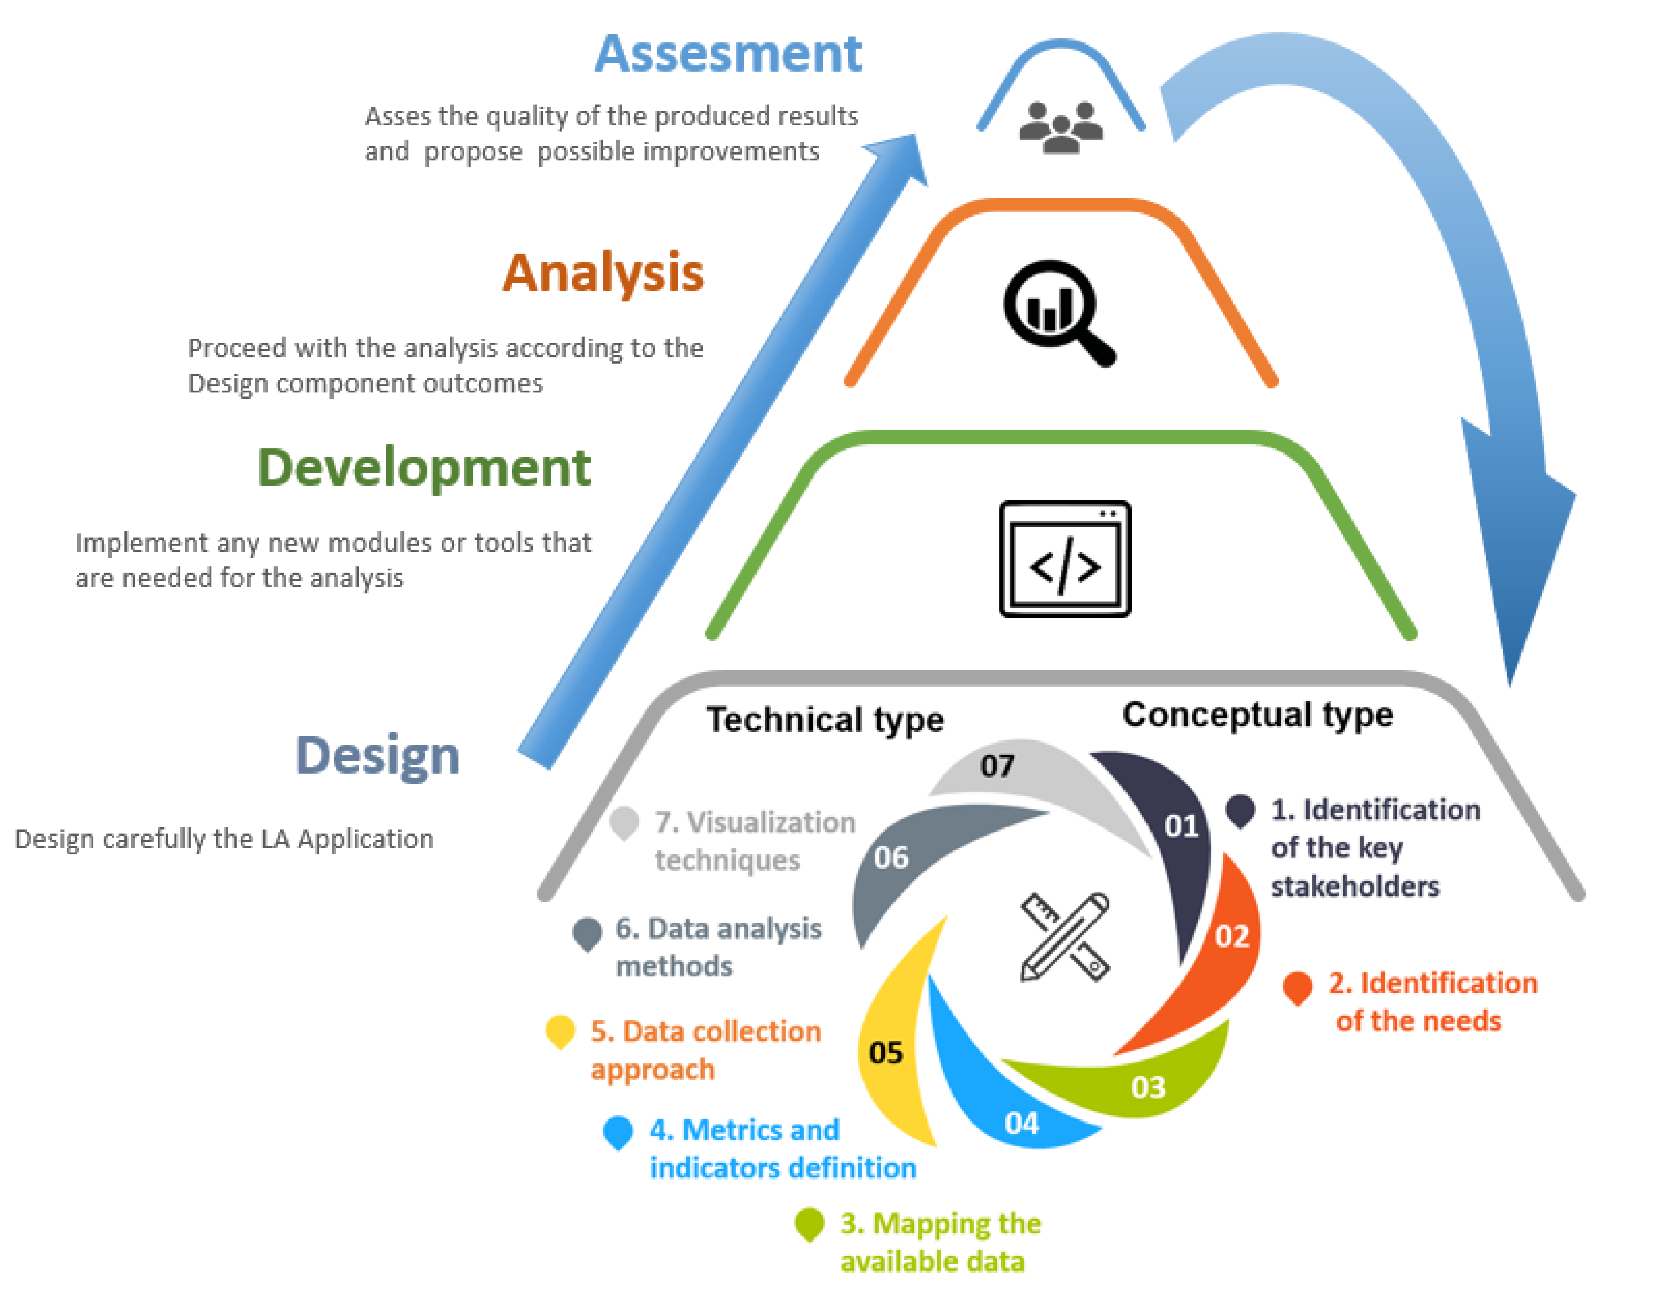
Outputs and visualization (in app)
PBI/other
Interim prototype implementation
Full Brewdat implementation
Analytics Playground brain
Data transformation and pre-processing
API
Temporary storage (SQL, RDBMS)
Brewdat Data Portal
Knowledge graph/semantic layer
Other sources (GCP)
Source systems/ADLS Gen2/S3

